Slide 1
Travel
By Ng Wei Yuen ICT 1-1

Slide 2
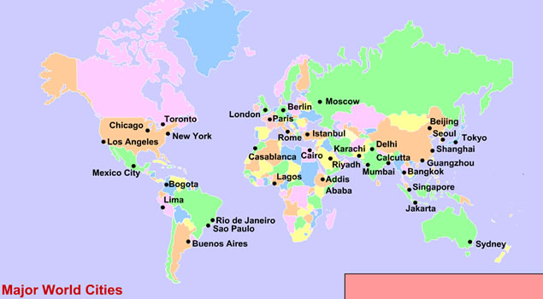
Cities to Travel to
Cities
Bali
London
Paris
Rome
New York
Crete
Barcelona
Siam Reap
Prague
Phuket

Slide 3
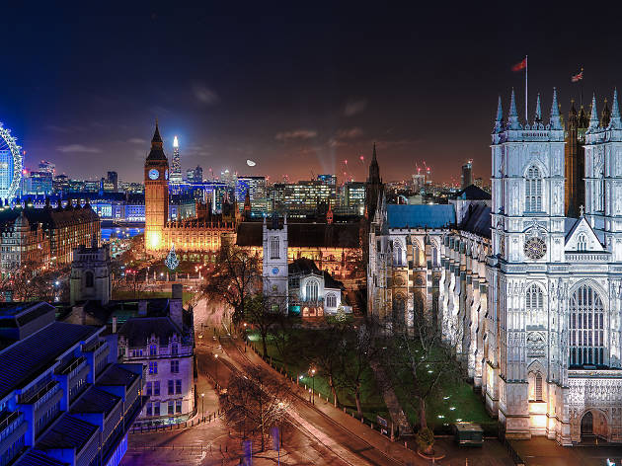
Bali
Bali
Island in Indonesia
home to an ancient culture that's known for its warm hospitality

Slide 4
lONDON
lONDON
Capital city of UK
LONDON Bridge’s here

Slide 5
Paris
Paris
Capital city of France
Eifel tower’s here

Slide 6
Rome
rome
Capital city of Italy
Roman Coliseum’s here

